Slide 1
M V C
Model-View-Controller

Slide 2
The Model-View-Controller (MVC) architectural pattern separates an application into three main components: the model, the view, and the controller
The ASP.NET MVC framework is a lightweight, highly testable presentation framework that (as with Web Forms-based applications) is integrated with existing ASP.NET features

Slide 3
Models
Business logic belongs in the model.
Model objects are the parts of the application that implement the logic for the application's data domain.
Model objects retrieve and store model state in a database.
For example, a Product object might retrieve information from a database, operate on it, and then write updated information back to a Products table in a SQL Server database.

Slide 4
View
The UI logic belongs in the view
Views are the components that display the application's user interface (UI).
Typically, this UI is created from the model data.
An example would be an edit view of a Products table that displays text boxes, drop-down lists, and check boxes based on the current state of a Product object.

Slide 5
Controllers.
Input logic belongs in the controller.
Controllers are the components that handle user interaction, work with the model, and ultimately select a view to render that displays UI.
In an MVC application, the view only displays information; the controller handles and responds to user input and interaction.
For example, the controller handles query-string values, and passes these values to the model, which in turn might use these values to query the database.

Slide 6
Advantages of an MVC-Web Application
It makes it easier to manage complexity by dividing an application into the model, the view, and the controller.
It does not use view state or server-based forms. This makes the MVC framework ideal for developers who want full control over the behavior of an application.
It works well for Web applications that are supported by large teams of developers.

Slide 7
Features of the MVC Framework
Separation of application tasks (input logic, business logic, and UI logic).
You can use any unit-testing framework that is compatible with the .NET Framework.
An extensible and pluggable framework.
The components of the ASP.NET MVC framework are designed so that they can be easily replaced or customized
You can plug in your own view engine, URL routing policy, action-method.

Slide 8
The ASP.NET MVC framework also supports the use of Dependency Injection (DI) and Inversion of Control (IOC) container models.
DI enables you to inject objects into a class, instead of relying on the class to create the object itself.
IOC specifies that if an object requires another object, the first objects should get the second object from an outside source such as a configuration file.
This makes testing easier.

Slide 9
Powerful URL-mapping component that lets you build applications that have comprehensible and searchable URLs.
URLs do not have to include file-name extensions
Support for using the markup in existing ASP.NET page (.aspx files), user control (.ascx files), and master page (.master files) markup files as view templates.
You can use existing ASP.NET features with the ASP.NET MVC framework,

Slide 10
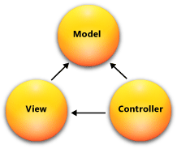
Model – Data retrieve and store, Database operations.
View - Components that display the application's user interface (UI).
Controller – User Interaction

Slide 11
Entity Framework
The Microsoft ADO.NET Entity Framework is an Object/Relational Mapping (ORM)
It enables developers to work with relational data as domain-specific objects
Using the Entity Framework, developers issue queries using LINQ, then retrieve and manipulate data as strongly typed objects.
The Entity Framework's ORM implementation provides services like change tracking, identity resolution, lazy loading, and query translation so that developers can focus on their application-specific business logic rather than the data access fundamentals.
Or simply: Entity framework is an Object/Relational Mapping (O/RM) framework. It is an enhancement to ADO.NET that gives developers an automated mechanism for accessing & storing the data in the database, and for working with the results, in addition to Datareader and Dataset.

Slide 12
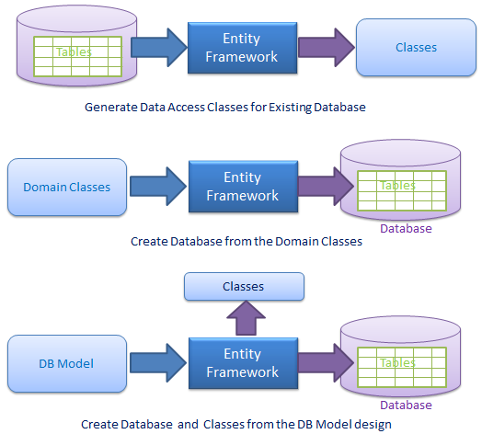
Entity Framework

